Slide 1

FAST
National University of Computer and Emerging Sciences Peshawar
OOP Lab # 1.2
C++ Variables and Data Types Instructor: Mazhar Iqbal
DEPARTMENT OF COMPUTER SCIENCE
Prepared By: Mazhar Iqbal (Instructor CS)

Slide 2

Contents
C++ Comments
Keywords
Tokens
Variables
Rules for naming variables
Data Types
C++ Constants
C++ Input

Slide 3
C++ Comments
A well-documented program is a good practice as a programmer. It makes a program more readable and error finding become easier. One important part of good documentation is Comments.
In computer programming, a comment is a programmer-readable explanation or annotation in the source code of a computer program
Comments are statements that are not executed by the compiler and interpreter.

Slide 4
Types of comments
Single line comment
Multi-line comment

Slide 5
Single line Comment
Represented as // double forward slash.
It is used to denote single line comment.
It apply comment to a single line only.
It is referred as C++ style comments as it is originally part of C++ programming.

Slide 6
1) Single line Comment…
Example
#include<iostream>
int main() Output: Welcome to PFlab
{
// Single line Welcome user comment
cout<<"Welcome to PFlab";
return 0;
}

Slide 7
2) Multi-line Comment
Represented as /* any text */.
Start with forward slash and asterisk (/*) and end with asterisk and forward slash (*/).
It is used to denote multi-line comment. It can apply comment to more than a single line.
It is referred as C-Style comment as it was introduced in C programming.

Slide 8
2) Multi-line Comment…
#include<iostream>
int main()
{
/* Multi-line Welcome user comment
written to demonstrate comments
in C/C++ */
cout<<"Welcome to PF lab";
return 0;
}
Output:
Welcome to PF lab

Slide 9
Single or multi-line comments?
It is up to you which you want to use. Normally, we use // for short comments, and /* */ for longer.

Slide 10
C++ Keywords/Reserved Words
The words that are used by the language for special purpose are called keywords.
These are also called reserved words. For example in a C++ the word main is used to indicate the starting of program, include is used to add header files, int is used to declare integer type variable. All these words are keywords of C++.
The reserved words cannot be used as variable names in a program.

Slide 11
C++ Keywords…
A list of 32 Keywords in C++ Language which are also available in C language are given below.
auto | break | case | char | const | continue | default | do
double | else | enum | extern | float | for | goto | if
int | long | register | return | short | signed | sizeof | static
struct | switch | typedef | union | unsigned | void | volatile | while

Slide 12
C++ Keywords…
A list of 30 Keywords in C++ Language which are not available in C language are given below.
asm | dynamic_cast | namespace | reinterpret_cast | bool
explicit | new | static_cast | false | catch
operator | template | friend | private | class
this | inline | public | throw | const_cast
delete | mutable | protected | true | try
typeid | typename | using | virtual | wchar_t

Slide 13
Tokens
A program statement consist of variable names, keywords, constants, punctuations marks, operators etc. In C++ these elements of a statement are called tokens. In the following program segment:
main()
{
int a, b;
}
main, {, }, int , a, b and punctuation marks (,) and (;) are tokens of the program.

Slide 14
Variables
A named memory location where data is stored is called variable.
A quantity whose value may change during execution of the program is called variable. It is represented by a symbol or name.
Variable is name of reserved area allocated in memory. In other words, it is a name of memory location.
It is a combination of "vary + able" that means its value can be changed.
int age=20; // Here age is variable

Slide 15
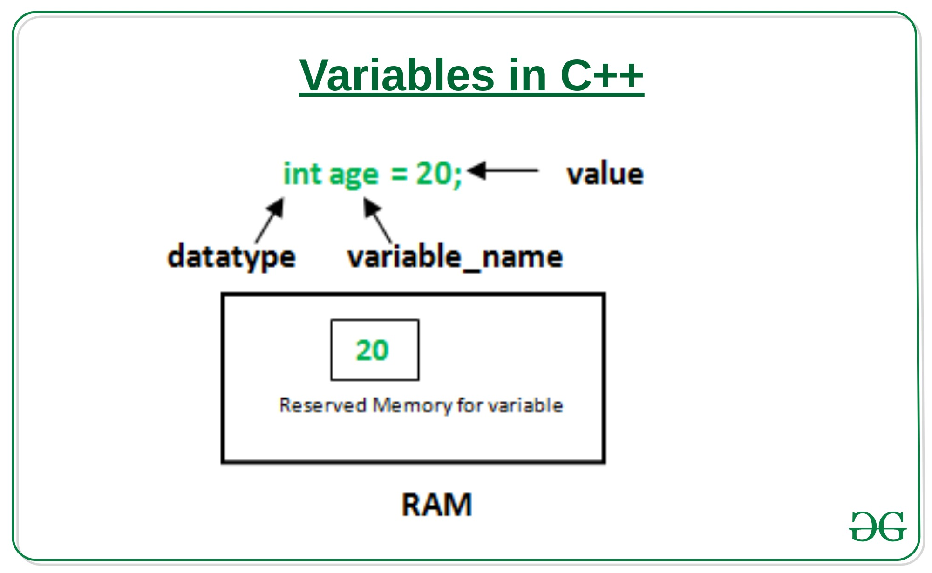
Variables…

Slide 16
Rules for Naming/Writing Variables
The first character of variable must be an alphabetic character.
Underscore can be used as first character of variable name.
Blank space are not allowed in a variable name.
Special character such as arithmetic operators, #, ^, cannot be used in a variable name.
The maximum length of a variable name depends upon the compiler of C++.
A variable name declared for one data type cannot be used to declare another data type.

Slide 17
Rules for Naming/Writing Variables…
C++ is a case sensitive language. Thus variable name with the same spellings but different cases are treated as different variable names. For example variable “Pay”
And “pay” are two different variables.

Slide 18
Rules for Naming/Writing Variables…_
C++ is a case sensitive language: number is different from Number or nUmber
Valid identifiers:
int abc, char aBc, int first_var, float first
Invalid identifiers:
int 3bc, int a*b, int #a, int void

Slide 19
Rules for Naming/Writing Variables…_
camelCase variable names:
number, firstName, dateOfBirth
PascalCase variable names
Number, FirstName, DateOfBirth

Slide 20
Rules for Naming/Writing Variables…
Rule of Thumb
Use camelCase for variable names
Use PascalCase for advanced naming e.g. Classes, Interfaces etc.

Slide 21
Rules for Naming/Writing Variables…
int firstNumber;
char gender = 'm’;
float piValue= 3.14;
int myAge, int countryName;
int a, b, c;

Slide 22
C++ Data Types
Data types specify the different sizes and values that can be stored in the variable.
Data Types tell us:
i) Type of data.
ii) Memory reserved (amount of memory).
iii) Range of value.

Slide 23
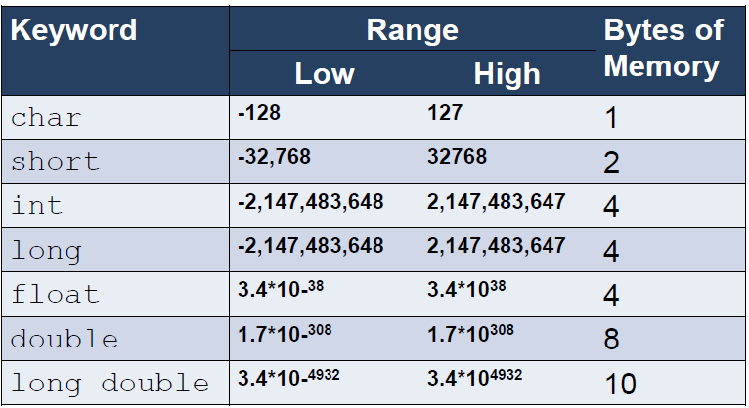
C++ Data Types…

Slide 24
sizeof() Data Type
sizeof() function is used to find size (bytes) of data type
e.g: sizeof(char)

Slide 25
sizeof() Data Type…
#include<iostream>
using namespace std;
int main()
{
cout << "Size of char : " << sizeof(char) << " byte" << endl;
cout << "Size of int : " << sizeof(int) << " bytes" << endl;

Slide 26
sizeof() Data Type…
cout << "Size of short int : " << sizeof(short int) << " bytes" <<endl;
cout << "Size of long int : " << sizeof(long int) << " bytes" << endl;
cout << "Size of signed long int : " << sizeof(signed long int)
<< " bytes" << endl;
cout << "Size of unsigned long int : " << sizeof(unsigned long int)
<< " bytes" << endl;

Slide 27
sizeof() Data Type…
cout << "Size of float : " << sizeof(float) << " bytes" <<endl;
cout << "Size of double : " << sizeof(double) << " bytes" << endl;
system(“pause”);
return 0;
}

Slide 28
sizeof() Data Type…
Output:
Size of char : 1 byte
Size of int : 4 bytes
Size of short int : 2 bytes
Size of long int : 8 bytes

Slide 29
sizeof() Data Type…
Output:
Size of signed long int : 8 bytes
Size of unsigned long int : 8 bytes
Size of float : 4 bytes
Size of double : 8 bytes

Slide 30
How to get the type of a variable in C++
#include <typeinfo>
#include <iostream>
using namespace std;
int main() {
int a; //declaring variable of type int
float b; //declaring variable of type float
double f =7.98; //declaring variable of type double
//we are passing the variable as a parameter in the function i.e typeid(variable_name)
cout << "\n Type of x: " << typeid(a).name();
cout << "\n type of b: " << typeid(b).name();
cout << "\n type of b: " << typeid(c).name();
return 0;
}
Output:
a is of type: i
b is of type: f
f is of type: d

Slide 31
How to get the type of a variable in C++…
We have used typeid for getting the type of the variables. typeid is an operator which is used where dynamic type of an object need to be known.
typeid(x).name() return shorthand name of the data type of x, for example, it return i for integers, d for doubles, Pi for the pointer to integer etc. But actual name returned is mostly compiler dependent.

Slide 32
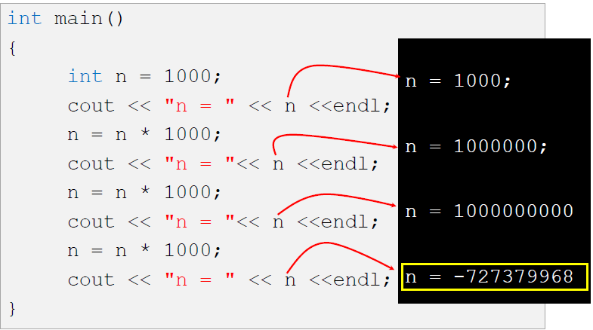
Integer Overflow

Slide 33
C++ Constant
When you do not want others (or yourself) to override existing variable values, use the const keyword (this will declare the variable as "constant", which means unchangeable and read-only)
Example
const int myNum = 15; // myNum will always be 15 myNum = 10; // error: assignment of read-only variable 'myNum'

Slide 34
C++ Constant…
You should always declare the variable as constant when you have values that are unlikely to change:

Slide 35
C++ Constant…
#include <iostream>
using namespace std;
int main() {
const int minutesPerHour = 60;
const float PI = 3.14;
cout << minutesPerHour << “\n";
cout << PI;
return 0;
}

Slide 36
C++ Input
You have already learned that cout is used to output (print) values. Now we will use cin to get user input.
cin is a predefined variable that reads data from the keyboard with the extraction operator (>>).
In the following example, the user can input a number, which is stored in the variable x. Then we print the value of x:

Slide 37
C++ Input…
#include <iostream>
using namespace std;
int main() {
int x;
cout << "Type a number: "; // Type a number and press enter
cin >> x; // Get user input from the keyboard
cout << "Your number is: " << x;
return 0;
}

Slide 38
C++ Input…
Good To Know
cout is pronounced "see-out". Used for output, and uses the insertion operator (<<)
cin is pronounced "see-in". Used for input, and uses the extraction operator (>>)

Slide 39
Creating a Simple Calculator
#include <iostream>
using namespace std;
int main() {
int x, y;
int sum;
cout << "Type a number: ";
cin >> x;

Slide 40
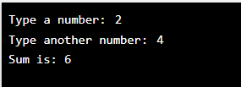
Creating a Simple Calculator…
cout << "Type another number: ";
cin >> y;
sum = x + y;
cout << "Sum is: " << sum;
return 0;
}

Slide 41
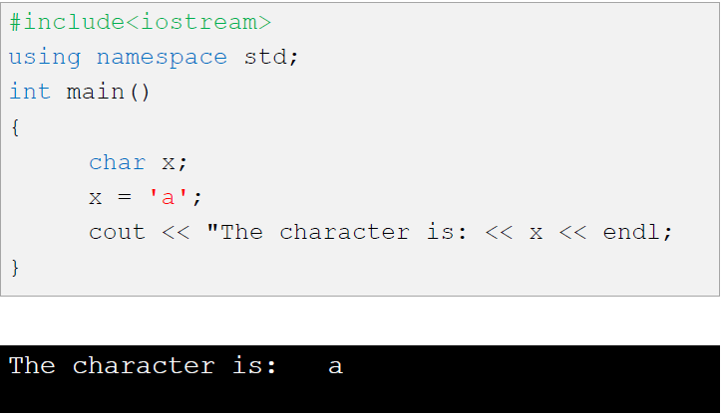
Using Character

Slide 42

Using Character…
#include<iostream>
using namespace std;
int main()
{
char ch;
cout<<"Enter any character: ";
cin>>ch;
cout<<"The character you entered is: "<<ch;
return 0;
}

Slide 43
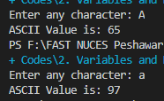
Using Character…
#include<iostream>
using namespace std;
int main()
{
char ch;
cout<<"Enter any character: ";
cin>>ch;
cout<<"ASCII Value is: "<<int(ch);
return 0;
}

Slide 44
References
https://beginnersbook.com/2017/08/cpp-data-types/
https://www.geeksforgeeks.org/c-data-types/
http://www.cplusplus.com/doc/tutorial/basic_io/
https://www.geeksforgeeks.org/basic-input-output-c/
https://www.w3schools.com/cpp/default.asp
https://www.javatpoint.com/cpp-tutorial

Slide 45

THANK YOU
Thanks

